Slide 1

Project Management

Slide 2
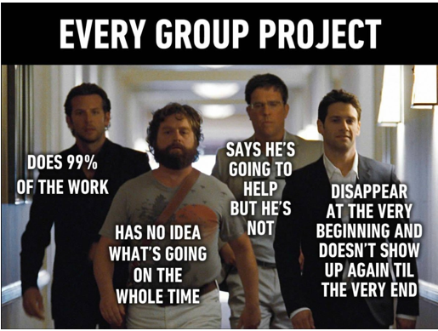
Project Management
Harsha ,20th FEB 2022

Slide 3
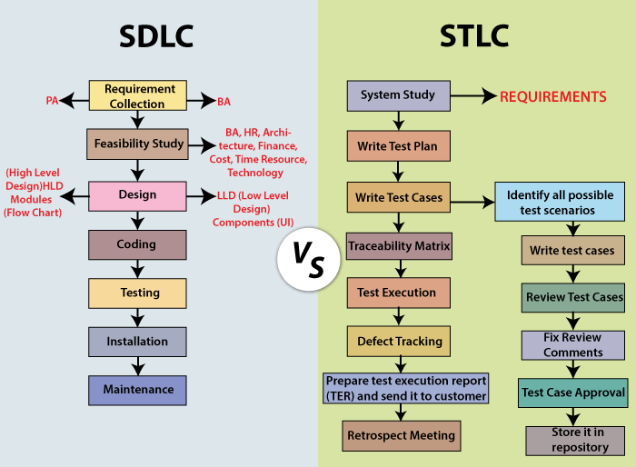
SDLC AND STLC
SDLC- SOFTWARE DEVELOPMENT LIFE CYCLE STLC- SOFTWARE TESTING LIFE CYCLE

Slide 4

Agile
Waterfall

Slide 5
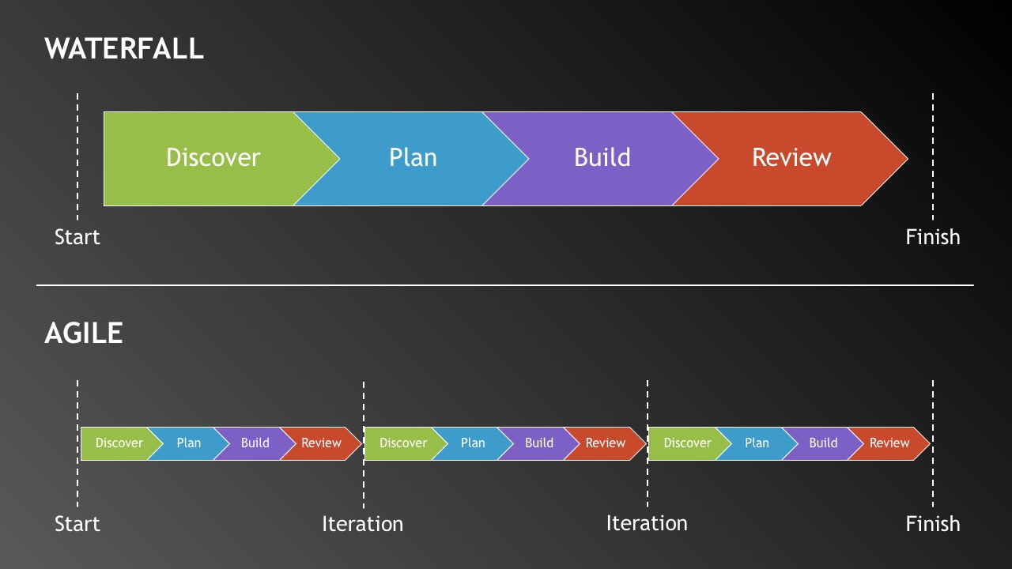

Slide 6
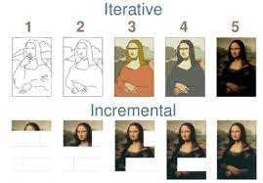

Slide 7
THE SCRUM BOARD
Stories | To Do | In-Progress | Testing | Done
Type your scrum stories here. This is your story to be added here
Type your scrum stories here. This is your story to be added here
Type your scrum stories here. This is your story to be added here
Type your scrum stories here. This is your story to be added here
Type your scrum stories here. This is your story to be added here
Type your scrum stories here. This is your story to be added here
Type your scrum stories here. This is your story to be added here
Type your scrum stories here. This is your story to be added here
Type your scrum stories here. This is your story to be added here
Type your scrum stories here. This is your story to be added here
Type your scrum stories here. This is your story to be added here
Type your scrum stories here. This is your story to be added here
Type your scrum stories here. This is your story to be added here
Type your scrum stories here. This is your story to be added here
Type your scrum stories here. This is your story to be added here
Type your scrum stories here. This is your story to be added here

Slide 8
Thank you!

